Slide 1
  Advance Java
  Servlet Session Management
LEVEL – PRACTITIONER

Slide 2
Objectives
After completing this chapter you will be able to:
  What is HTTP session
  Understand Session Management Techniques like,
    URL rewriting
    Hidden Fields
    Cookie
    Session Object

Slide 3

A Problem statement
Tim was developing an application where he has a requirement to display the Login name used during login across all the pages in the application. Knowing that HTTP is a stateless protocol he was wondering how he can achieve it?
Guess how Tim would have achieved it?
He used session management.

Slide 4
So what is Session Management?
Session Management is a mechanism for maintaining state across multiple HTTP requests. This is managed by the Web container.
In Simple words it is a technique to hold some values passed by user across multiple HTTP requests arising out from a single browser instance.
  How Tim solved the problem? Tim used session to store the Login name, thus it helped him to preserve the login name and access it from all the pages.
Session life cycle is managed for each web browser instance opened and it exists till the browser is closed (or) till the session time outs (set in the server configurations).

Slide 5
Back to the problem statement
Lets See How Tim would have developed it using Session management.
Scenario: The requirement is the user logs in using a Login page, the user name used during login should be displayed in home page and any other page requested by the user. NOTE: User name is not a parameter in the remaining pages.
Lets see how Tim would have achieved it.

Slide 6


Servlet without session tracking
Tim Log in the application passing user Name (R1)
Web container
LoginServlet
Login servlet responds back.
Tim Access Home page (R2)
HomePage
Servlet
Tim opens a
web browser
Home page displayed but without user name.
The second request for Home page, the user is NOT passing user name nor the value from request R1 is stored anywhere .
So home page cannot display the user name.

Slide 7
Servlet with session tracking
Web container
Tim Log in the application
Servlet stores the user name in session
LoginServlet
Session
Login servlet responds back.
User Name = “Tim”
Tim Access Home page
HomePage
Servlet
Tim opens a
web browser
Though the user name is NOT in the request it can print the user name by accessing the session.
Home page displayed with user name displayed.
In the above example if Tim opens a new browser and access Home page servlet the user Name cannot be accessed since a new HTTP Session object is created.

Slide 8
Need for Session ?
HTTP is a stateless protocol. So if developers need to develop pages where he needs to maintain the application user’s state across multiple request he can use session.
For Example, he can store the following information,
Login Name.
Users state/ City.
User ID number. Etc.

Slide 9
How is Session Tracked for a User ?
Each user session is tracked by unique ID called JSESSIONID
  This is similar to how a employee is identified in a organization using employee Id.
JSESSIONID will be generated the first time the user visits a site.
JSESSIONID will be generated for each browser instance.
  Example: When a user Tom access a site www.cognizant.com a JSESSIONID will be created say “101”. When Tom opens another browser and access the same site www.cognizant.com a new JSESSIONID , say “102” will be created to track that session.
For subsequent requests to the same site this ID will be used to track the user using tracking techniques like cookie, encoded url etc.

Slide 10
Session management techniques
The following are the session management techniques. These are used for managing the data’s between pages of the user in a session.
Hidden Fields
URL Rewriting
Cookies
Session Object
Let’s look at these one by one.

Slide 11


Servlet with session tracking
Lets consider the web mail application scenario and see how session management works.
Assume Ron & Tim access the web mail application
Web container
2. Login servlet creates
Session for Tim
HTTP Session
1. Tim Log in the application
Session Object #1
User Name = “Tim”
Location = “Chennai”
Login
3. Tim access Inbox
Tim
Inbox
4. Inbox uses Session
information to display
the name
Session Object #2
User Name = “Ron”
Location = “Chennai”
5. Tim Access Sent Item
Sent Item
6. Sent Item uses Session
information to display
the name
Ron
Now when Ron logs in a new “Session 2” will be created (Similar to step 2) and his user name and city will be stored in session. Steps 3~6 will be similar to Tim’s steps.

Slide 12
How are Session value stored?
Session Value Storage?
Session values are stored in key/value format similar to Map interface.
Each value would have a name bound to it for retrieving the values.
Example: Assuming the same web mail application scenario, Tim’s session object will look as below.
Where user Name and Location are Key.
Tim & Chennai are the respective values.
Attribute Name | Value
User | Tim
Location | Chennai

Slide 13
Http Session Important API’s
Method | Description
String getAttribute(String attributeName) | Returns the object/value bound with the specified attribute name in this session, or null if no object is bound under the name.
Enumeration getAttributeNames() | Returns an Enumeration of String objects containing the attribute names of all the objects bound to this session.
long getCreationTime() | Returns the time when this session was created
String getId() | Returns a string containing the unique identifier assigned to this session which is the jsessionID.
long getLastAccessedTime() | Returns the last time the client accessed the session object.

Slide 14
Http Session Important API’s (Cont)
Method | Description
void invalidate() | Invalidates this session and removes any objects/values stored in it.
void removeAttribute(String attributeName) | Removes the object/value bound with the specified attribute name from this session.
Void setAttribute(String attributeName,Object value) | Sets an object/value to this session, using the attribute name specified.
int getMaxInactiveInterval() | Returns the maximum time in seconds for which the current session will be maintained inactive.
void setMaxInactiveInterval(int interval) | Specifies the time, in seconds, between client requests before the servlet container will invalidate this session.

Slide 15
How to access the Session Object
Session object associated with a user session is read from the user HTTP request using the getSession() method of the HttpServletRequest interface.
Syntax :
HttpSession session=request.getSession();

Slide 16
How to set values in HTTP Session
Values can be set to the session object using setAttribute() method of the HttpSession interface.
Syntax :
HttpSession session=request.getSession();
session.setAttribute(String attributeName,Object value);
Example: Taking the same Web mail application where user Name and location are stored.
HttpSession session=request.getSession();
session.setAttribute(“User”,”Tim”);
session.setAttribute(“Location”,”Chennai”);

Slide 17
Retrieve attributes from Session
Values can be set to the session object using getAttribute() method of the HttpSession interface.
Syntax :
HttpSession session=request.getSession();
Object variable=session.getAttribute(String attributeName);
Example: Retrieving userName and Location set in previous slide
HttpSession session=request.getSession();
String userName = (String) session.getAttribute(“User”);
String location = (String) session.getAttribute(“Location”);

Slide 18
Removing Attributes from Session ?
Values can be set to the session object using removeAttribute() method of the HttpSession interface.
Syntax :
HttpSession session=request.getSession();
session.removeAttribute(String attributeName);
Example: Assume we need to remove the user Name attribute “Tim” from the session, the following API needs to be fired on the Tim’s HTTP request object.
HttpSession session=request.getSession();
session.removeAttribute(“user”);

Slide 19
How to invalidate a session ?
Session invalidating is the process of unbinding the session object from the user thereby removing all the previously stored data in the session and freeing the memory. To invalidate a session we call the invalidate() method.
When is this used?
This is typically used when user loogs off from a web application to free up the memory utilized by the Session object.
Syntax :
HttpSession session=request.getSession();
session.invalidate();

Slide 20
Lend a Hand- Using Session object
In this demo the associates get familiarized with the technique of session management using HttpSession Object.
Scenario: We will use the web mail application that we have used in the URL redirect demo and see how session can solve the problem. We will create an additional link logout for the user to logout of the application and also add a logic to ensure that the user can access his inbox and sent items page only if he has logged in the application.
Components :
login.html :- Login page
LoginServlet :- Action page for the login page
Inbox Servlet :- The inbox of the user
SentItemsServlet :- The sent items page for the user.
Logout servlet: For the user to logout.

Slide 21
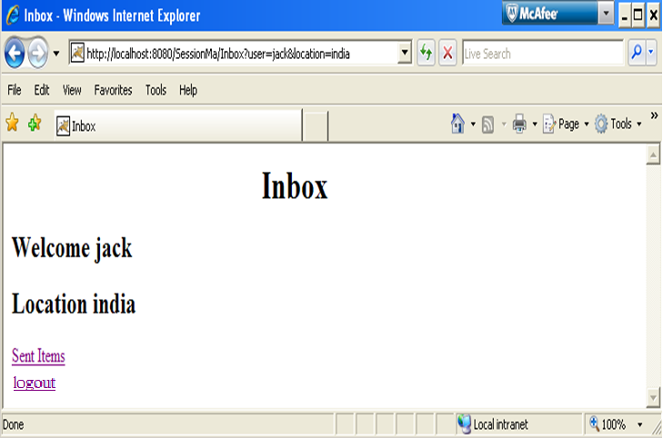
Lend a Hand- Inbox ScreenShot

Slide 22
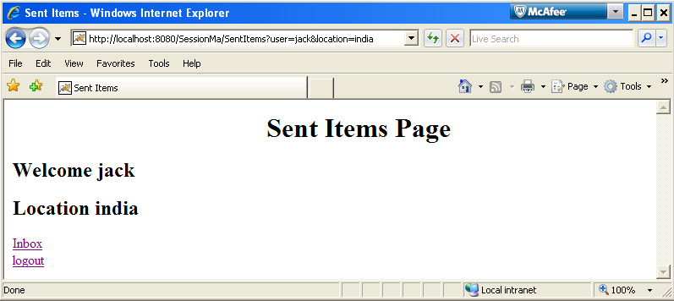
Lend a Hand – Sent Items Screenshot

Slide 23
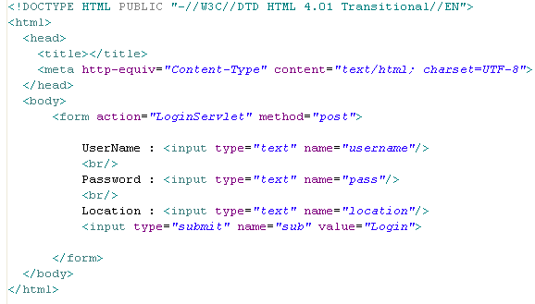
Lend a Hand: Develop a Login html
Develop the Login HTML as mentioned below, It should have the following fields,
User Name
Password
Location , submit action should be the LoginServlet.

Slide 24
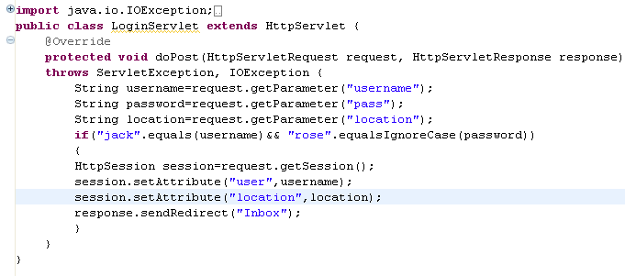
Lend a Hand: Develop a Login Servlet
Develop the login servlet which access the session and sets the attributes user name and location in the session and redirects the request to inbox.
Gets the session object from the request
Sets attribute to session

Slide 25
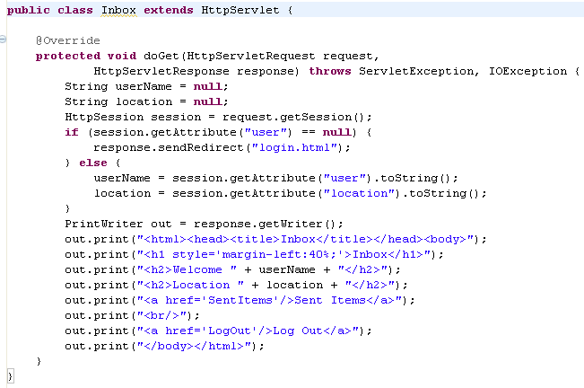
Lend a Hand: Develop a Inbox Servlet
Inbox Servlet should access the attributes and if the attributes are not set it will redirect to the login page.
Reads the session attribute. If attribute not set (user not logged in) it redirects to login page.
Reads the session attribute user name/Location and used for displaying it in the page.

Slide 26
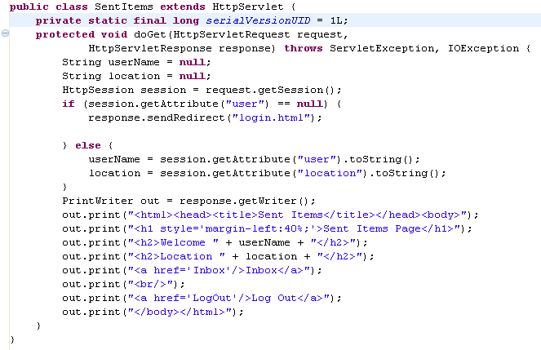
Lend a Hand: Develop a Sent Items Servlet
Similar to inbox servlet the sent item servlet read the values from the session, checks for login if not redirects to login HTML and displays the user name and location.

Slide 27
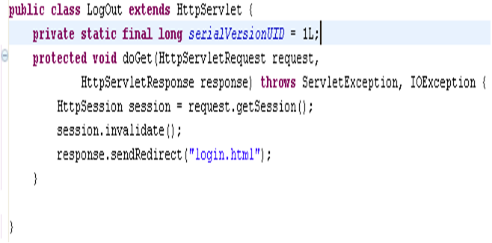
Lend a Hand: Develop a Logout Servlet
When the logout link is clicked this servlet will be accessed and will clear the session using invalidate method and remove the attribute user.
Invalidates the session object. Invalidating the session removes the entire session object and hence the entire set of session attributes.

Slide 28
Lend a Hand: Deploy and Run
Step 1 : Deploy the application.
Step 2: Try to call Inbox from browser.
http://localhost:8080/Session/Inbox
You will see that you will be redirected to the login.html page since you haven’t logged in and hence session value is not set.
Step 3 : Enter the details in login.html and press login. You will be redirected to Inbox page where the welcome message is displayed with the location and user name.
Step 4 : Click Sent Items link and you can see sent items page where the welcome message is displayed with the location and user name.
Step 5 : Click logout link in any of the pages. You will be redirected to login.html.

Slide 29
Tips on Using Session Object
Session objects are stored in server and it utilizes memory. So store only the needed information in sessions. Avoid bulky objects in session this can result in “out of Memory Error” resulting in a application crash.
Whenever a user closes the browser or logs out of the web application remove the session attributes set using the invalidate() and remove() API’s.

Slide 30
Pros and Cons of Using Http Session
Pros :
Simple to use since managed in the server.
Can function even when the cookie functionality is turned off in the browser.
Cons :
Since session objects are stored in the server the server memory required is more which is costly.

Slide 31
General Tips for using session Management Techniques.
Typically in Projects we use Session technique for holding the user attributes.
Cookies are rarely used as there could be users accessing browsers without cookie support.
If there is some state which is maintained in one or few pages, we use URL rewriting or hidden fields.
Most Importantly never load session object with bulky objects. Load only the states which are used across the web application.

Slide 32
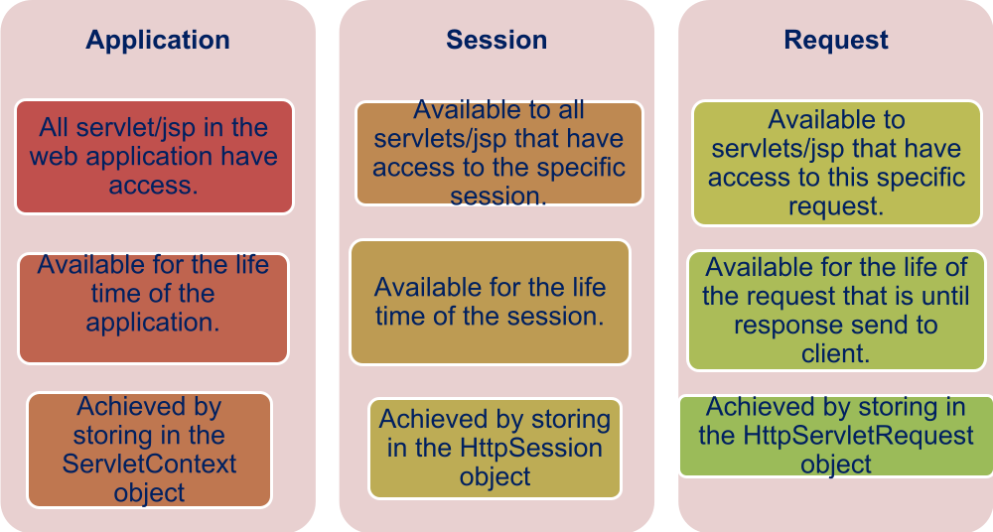
Attribute Scopes in Servlet

